Slide 1
The water wave
BY XUANQI WANG, TIANCHI YU AND ZEZHI YANG

Slide 2
MOTIVATION
We have studied mechanical wave, electromagnetic wave,
and even some gravitational wave.
But what about our first example of wave: water wave?

Slide 3
What kind of waves is water wave?
WATER WAVE IS TRANSVERSE WAVE, LONGITUDINAL WAVE OR SOMETHING ELSE?

Slide 4
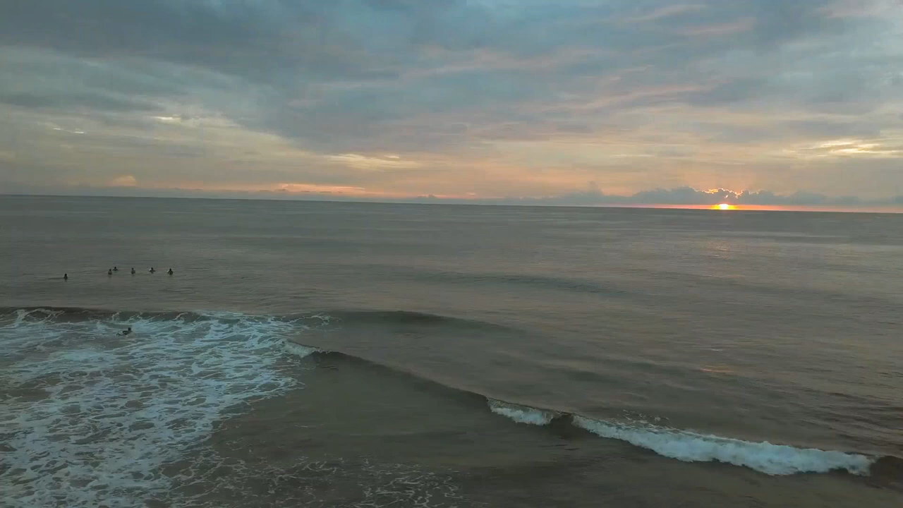

Slide 5
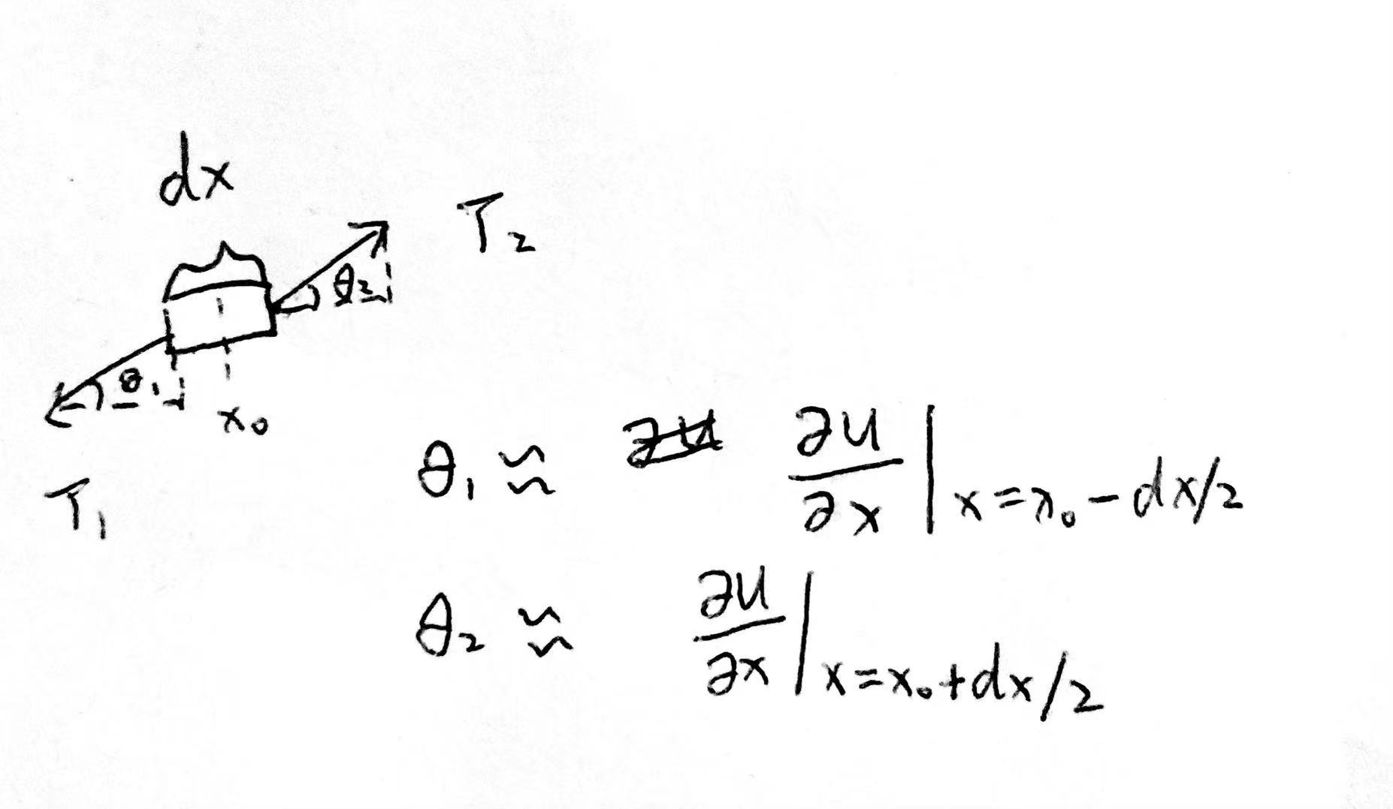
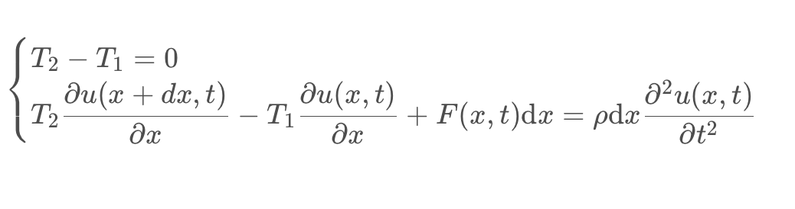
CALCULATION

Slide 6

THEOREM
$$∂_{x}^{2}u_{x}=\frac{ρ}{T}∗∂_{t}^{2}u_{x}$$
$$∂_{x}^{2}w_{z}=\frac{1}{K}∗∂_{t}^{2}w_{z}$$

Slide 7
WE SIMULATE SURFACE WAVE

Slide 8
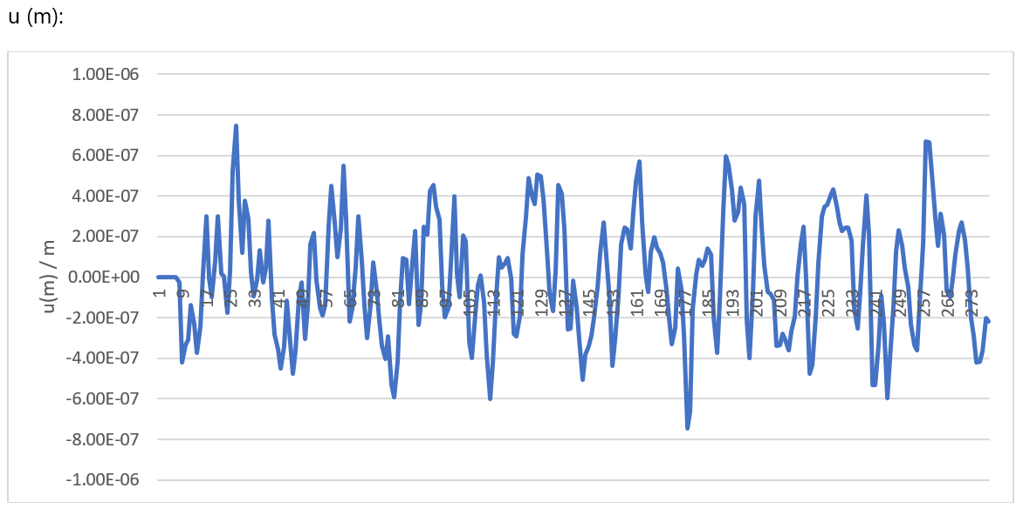
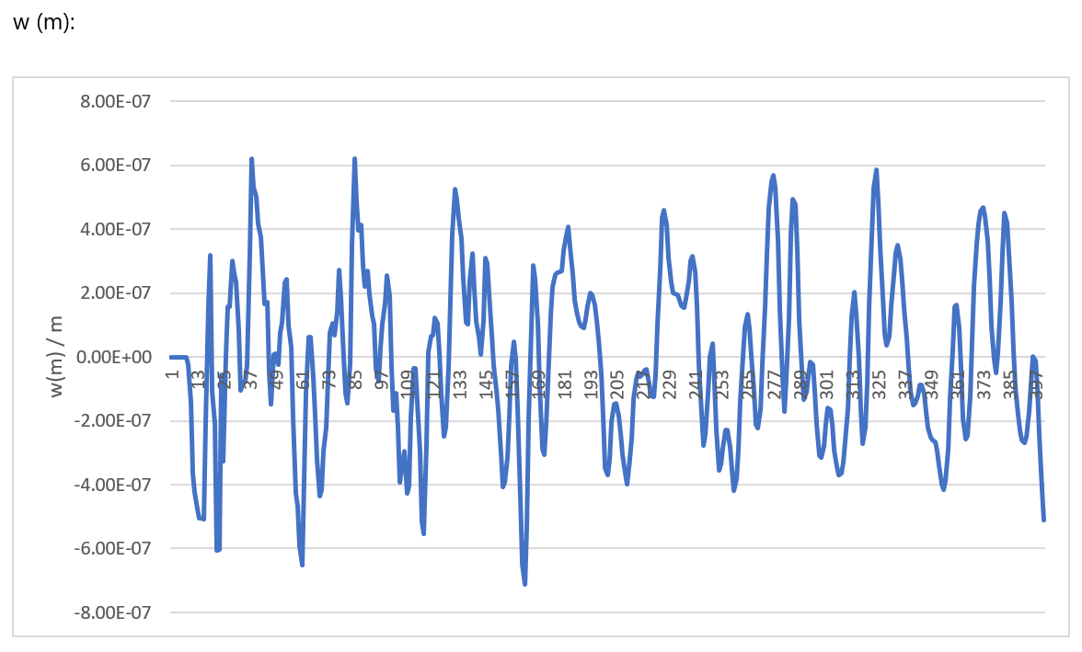
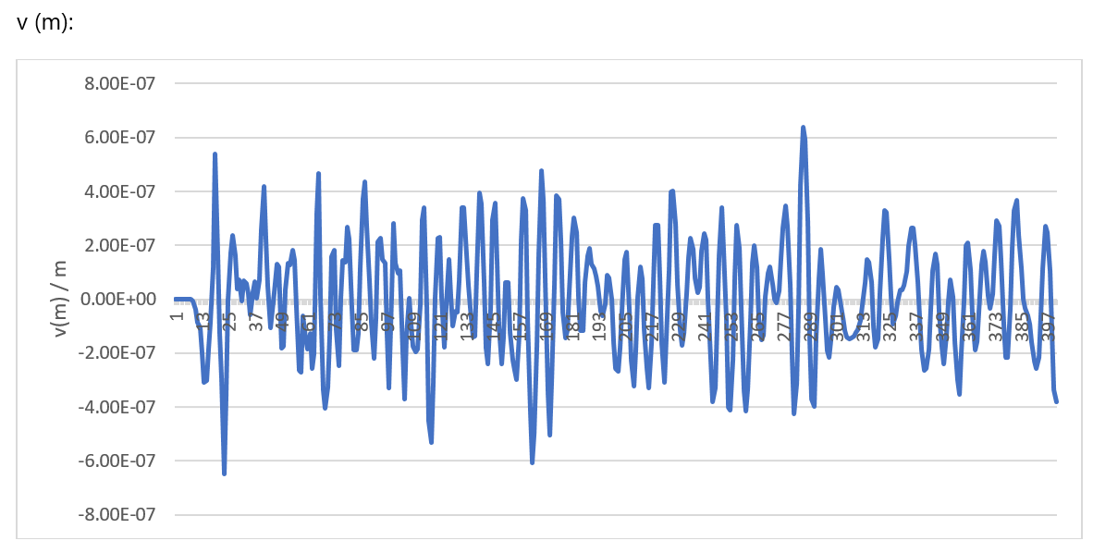
Simulation data

Slide 9
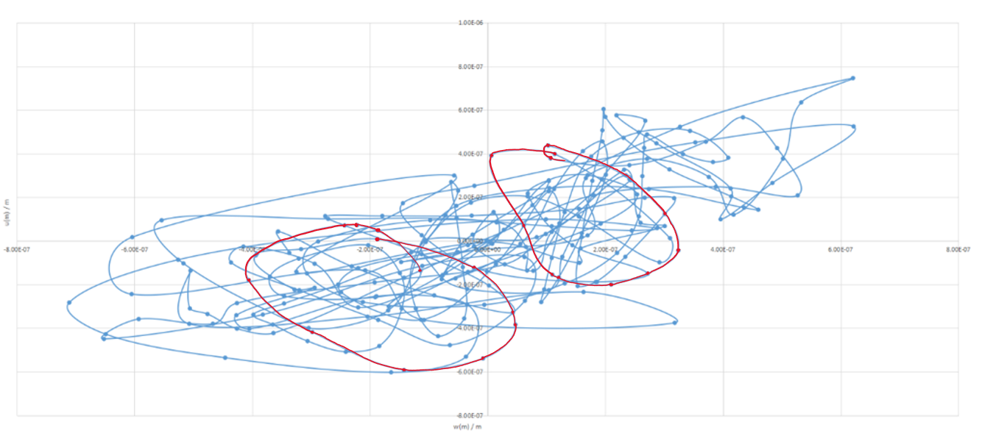
Simulation data

Slide 10
SHORTCOMINGS
We will find a suitable rubber block or something else to achieve our experiment in reality.
In our simulation, different from normal, the x axis is vertical, the z axis is
horizontal and y axis is perpendicular to both.
During the calculation, we ignored the non homogeneous part to simplify our calculation steps.

Slide 11
IMPROVEMENTS
We will perfect our theorem by adding the non homogeneous part.
We will try to achieve the experiment in reality, physically.
Then we will use the Deeplabcut to analyze our experiment video.

Slide 12
THANK YOU!

